Slide 1
Data Analysis of The Times Higher Education and
World Development Indicators: Insights and Findings
DOPP Group 11 :
Ilija Filipovski, Marko Pajkovski, Dario Jugo, Mirjana Sadikovikj

Slide 2
Introduction
Data analysis of two datasets:
World Development Indicators (WDI)
The Times Higher Education (THE)

Slide 3
Introduction
Building a predictive model
Question 1
Question 3
Question 2
How do university rankings change over time?
Which characteristics of universities contribute most to good rankings, or to large changes in the ranking position? Are there predictors for increases or decreases in the rankings?
How do these characteristics correlate with characteristics of cities or countries in which the university is located?

Slide 4
Data Preprocessing
Reshaping
Replace wrong country names
Interpolating null values
Creating continent feature
Creating new total score feature

Slide 5
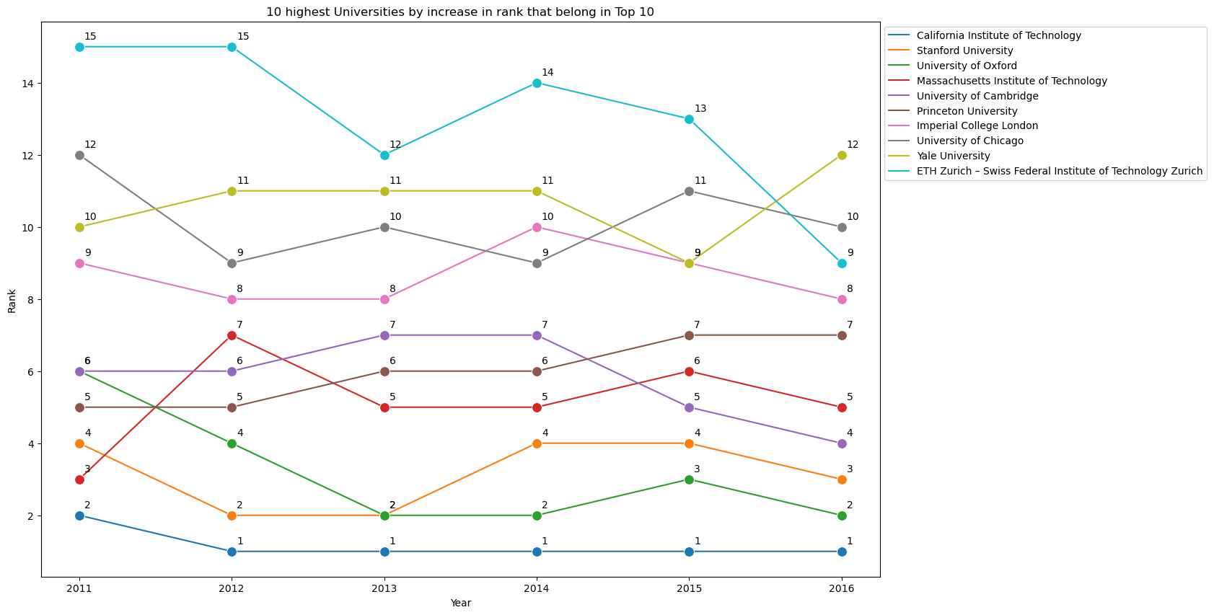
How do university rankings change over time?
Q1

Slide 6
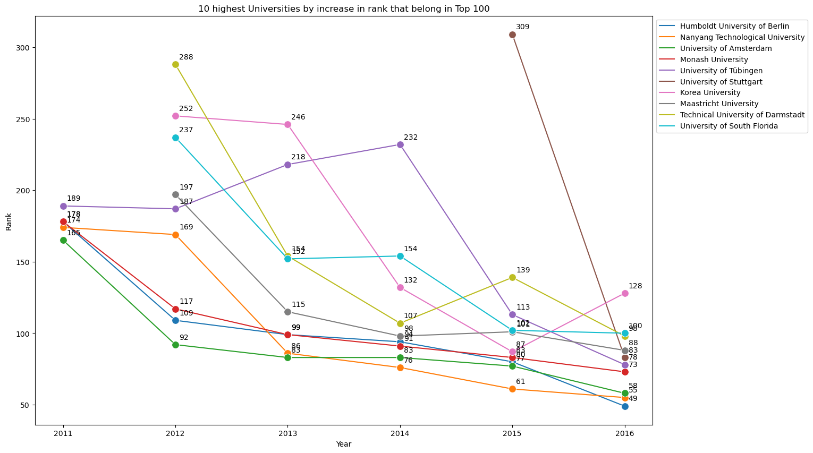
How do university rankings change over time?
Q1

Slide 7
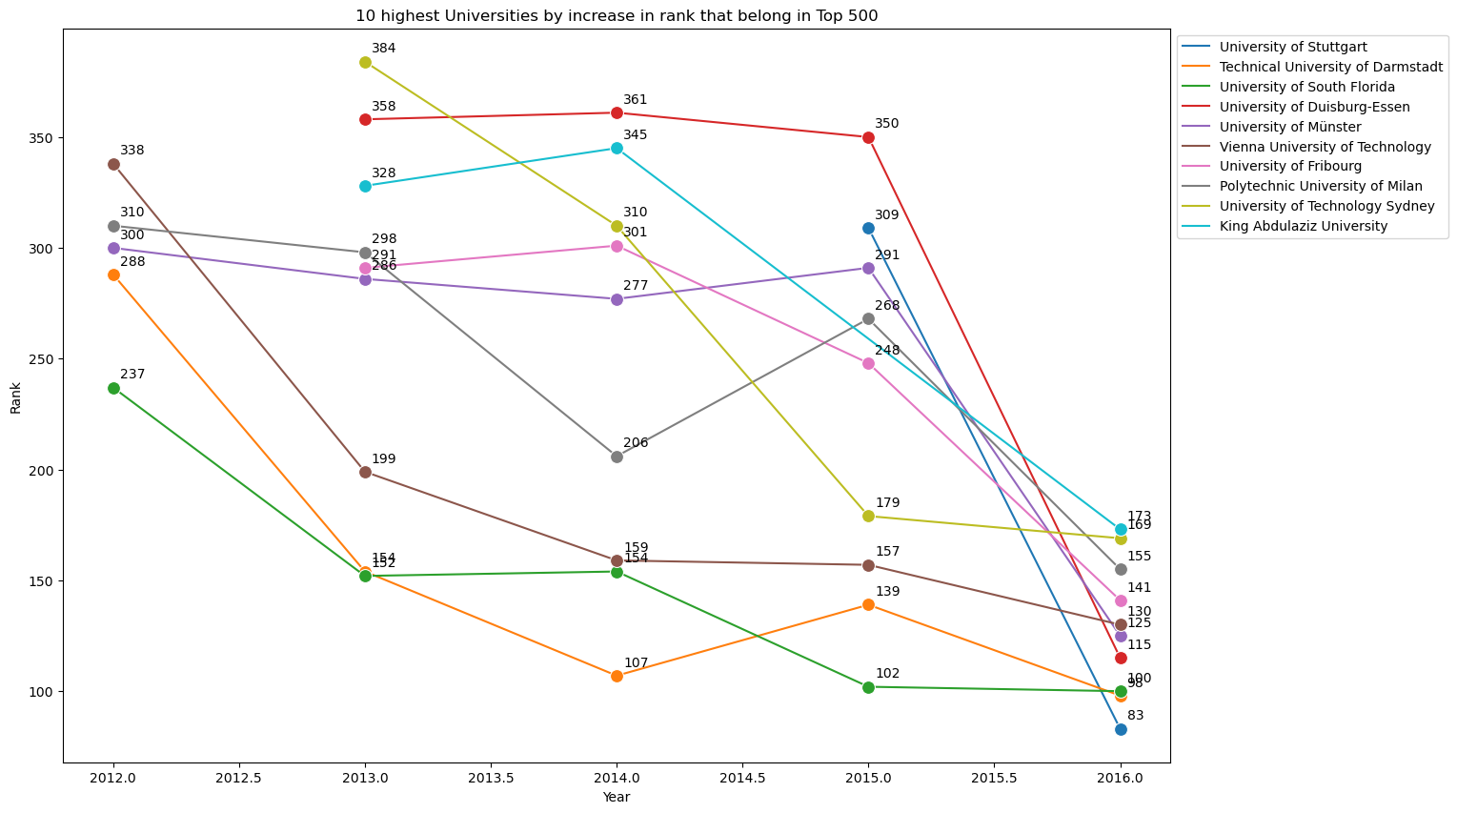
How do university rankings change over time?
Q1

Slide 8
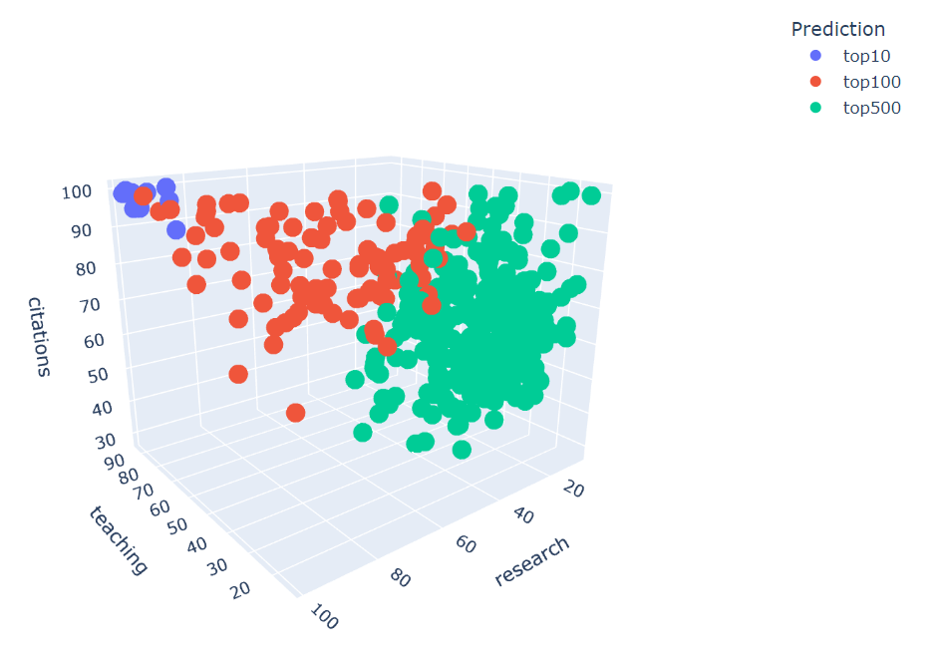
Which characteristics of universities contribute most to good rankings, or to large changes in the ranking position? Are there predictors for increases or decreases in the rankings?
Q2

Slide 9
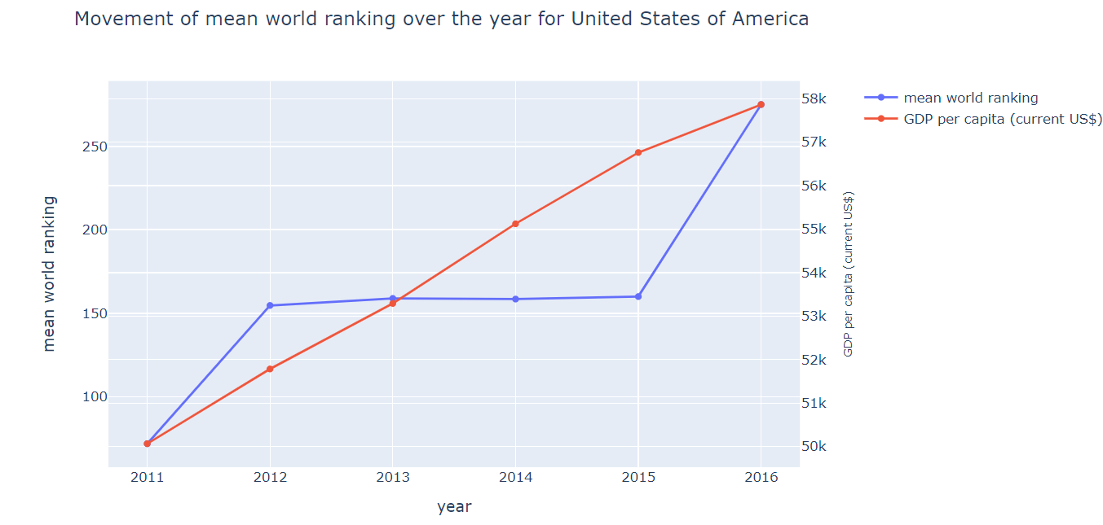
How do these characteristics correlate with characteristics of cities or countries in which the university is located?
Q3

Slide 10
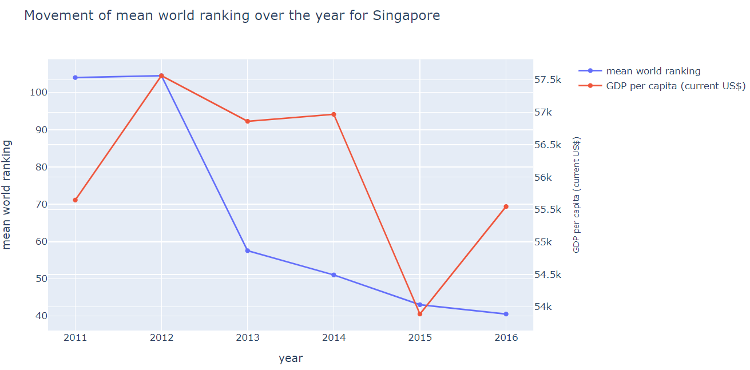
How do these characteristics correlate with characteristics of cities or countries in which the university is located?
Q3

Slide 11
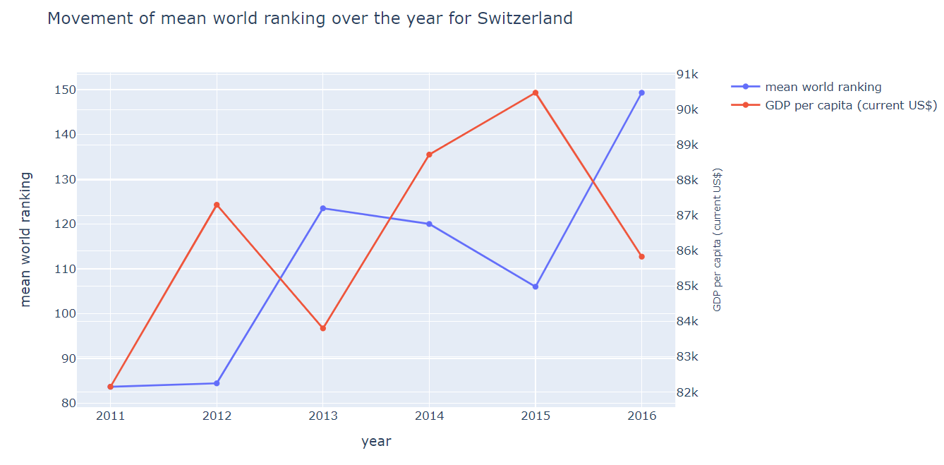
How do these characteristics correlate with characteristics of cities or countries in which the university is located?
Q3

Slide 12
Conclusion
The data analysis of the THE and WDI datasets has provided valuable insights and findings related to the question being asked and the predictive model.
The insights and findings from this analysis can be used to inform decision making and identify areas for improvement.
Further analysis and data cleaning should be conducted to ensure the accuracy and completeness of the data.

